Slide 1
关于设计的遐思
赫杰辉

Slide 2
Agenda
设计初探
再聊聊设计
不要犯这些错
开发人员到底要什么？
下一步
Q&A

Slide 3
设计初探
大道至简
Misunderstanding about design
What design really is
Two levels of design
Common design
System evolving
Notes:
Level2 - Ending should be preferably before merge week, but can be during the merge week

Slide 4
Misunderstanding about design
There is no practical course in college teaches design and coding
The self education is not always on track
Design is more like art than science
Make it work does not also mean the design is good
It is not you, but the system defines itself
You are not designing the system, you are just reveal how the system should be designed

Slide 5
What design really is
Orthogonality
The fundamental rule to construct things, include software system
    Minimal energy required
Computer science
    Orthogonality is a system design property facilitating feasibility and compactness of complex designs. Orthogonality guarantees that modifying the technical effect produced by a component of a system neither creates nor propagates side effects to other components of the system.
    The emergent behavior of a system consisting of components should be controlled strictly by formal definitions of its logic and not by side effects resulting from poor integration, i.e. non-orthogonal design of modules and interfaces.
    Orthogonality reduces testing and development time because it is easier to verify designs that neither cause side effects nor depend on them.
Example
    A car has orthogonal components and controls (e.g. accelerating the vehicle does not influence anything else but the components involved exclusively with the acceleration function). On the other hand, a non-orthogonal design might have its steering influence its braking (e.g. Electronic Stability Control), or its speed tweak its suspension.

Slide 6
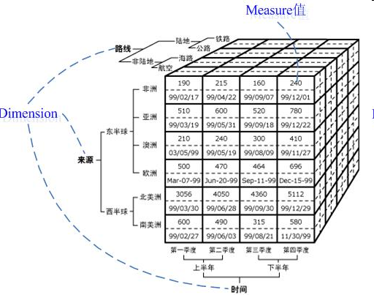
Find your X,Y,Z
All design is about to find out what's your systems’ X, Y, Z
Design is all about MATH
The most complex thing is to make it simple

Slide 7
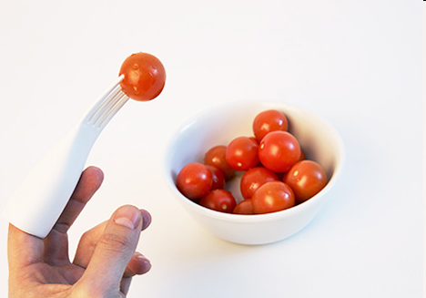
Two levels of Design--Level 1
High level design -- Define what the system is
  A well-designed system should have very few classes/interfaces which define the overall interaction very clearly at a high level.
  It should be worked out quickly and easily, can be explain to people within one piece of paper.
  For a typical system, usually includes Controller, Worker Interface

Slide 8
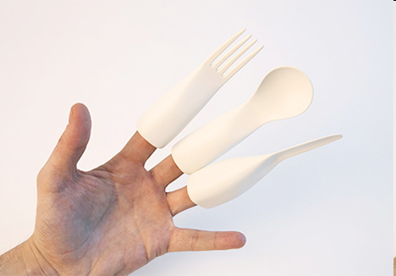
Two levels of Design--Level 2
Detail design -- How to handle variations
  Purely focus on the implementation of Worker Interface.
  Again, there could be another two levels of design here
  No matter how implementation changes, the high level design should not be impacted, so there should be no micro management, no detail leaking

Slide 9
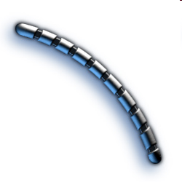
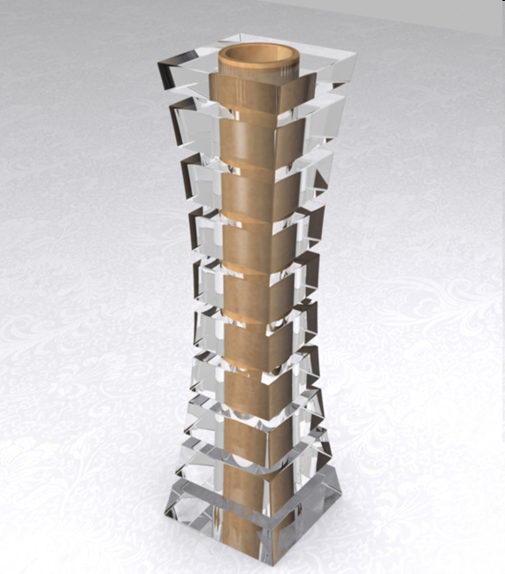

Common Design
Where is the X, Y, Z?
  Chain
  Branch
  Stack
When to use

Slide 10
System evolving
A good design does allow system evolving
  There should be no change in high level design.
  It supports the evolving in different dimension, no matter informational or behavioral
  Easy to find out where to extend.
  There is a pin-point where you can harness the code.
Centralize logic with BO (utility)/ how to handle variant
  The most evil thing you can do with code is to scatter similar/related/same logic all around.

Slide 11
再聊聊设计
知其然，知其所以然
Learn design from natural
Common design guideline
Standards for Good Interface
Sub-classing
Default implementation and extension
Design quality
Not the End

Slide 12


Learn design from natural
There is awesome design out there

Slide 13
Common design guideline
From general to specific
It is very hard to define top level interface very well
  Because it is hard to keep it simple and generic
  The more methods it has, the worse the design it is.
Define interface, abstract class and subclass like this:
  Top level interface should have as less as possible method. Same as the parameter. Basically one is perfect and two is too many.
    Give method a general name which describe the overall problem you want to solve.
    Use value object instead of combination of primary types as parameter and return type to make it open for extension from information perspective. If not, you will get big trouble if you add new parameters into top level interface.
  Abstract class should act as an adapter which connect top level interface and subclass.
    It needs to centralize common logic for certain use cases by implement all methods defined in top level interface. It is a bad smell if not.
    It should also define new abstract method to enable domain specific implementation for subclass.
  Subclass should only implement the abstract method defined in direct parent abstract class.
    Do not re-implement any method in top level interface and parent abstract class. It is a bad smell.
    Leaf level subclass will just implement all the abstract methods defined in direct parent class.
Same applies to component design, method, any unit of logic or data
  Make sure each of the top level component focus on different thing

Slide 14
Standards for Good Interface
The success of interface is measured by how many implementations it has
  The more, the better.
  Look back to the big family in human society, you will agree on that.
One interface with only one implementation
  It is a bad design. In such case, we should only use the real implementation directly.

Slide 15
Sub-classing
Double check if you really need to create subclass
  Consider object combination first
Methods should be orthogonal between parent and children
  Orthogonal means each focus on different task, avoid ambiguous when add or maintain function
  Every non-abstract public method should be final to make sure the orthogonal
It is a bad smell if a subclass needs to implement method not defined in direct parent class,
  Indicator of the connection between grand pa and grandson is not cut by parent class in the middle and cannot allow implementation focus on the clear range that set by parent class
It should define as less abstract class as possible
  The more abstract class in the middle, the more complex the system is
  Hard to understand, easy to make mistake because of too many choices
  Just like the same thing in management, the flat management

Slide 16
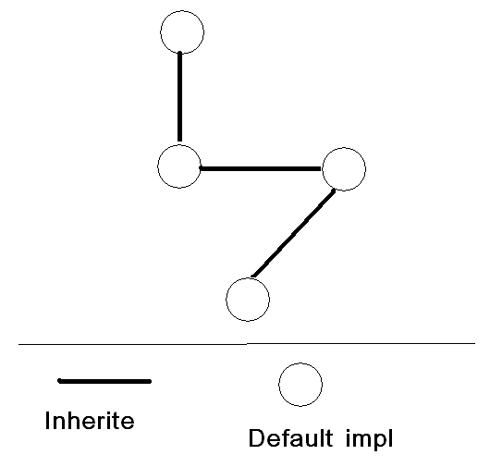
Default implementation and extension
Always provide a default implementation at each level, and allow further extension
  Default data converter
  Default validator for input data
  Default UI for data editor
  Default xxx
Benefit
  Allow system evolving
  Allow immediately use of system

Slide 17
Design quality
The universal quality: do the same thing with lest effort
The effort of design:
  Number of files
  Number of different language
  Number of different tool
  Number of steps
  How complex for most cases
  Easy to understand, use, maintain
Design is to
  Prevent mistake not encourage mistake.
  Keep simple things simple
  Make complex thing simpler
  To make life easy, not difficult
  Make sure nothing under radar

Slide 18
Design quality
Good design is hard to be noticed because everything is smooth
If you feel uncomfortable with something, think about why. It is a good chance to learn and improve
It is always complex to keep things simple
  Keep things simple and provide a well balanced solution need much time to polish
  Behind a simple solution which is easy to use are many thoughts and trade off
  Behind a complex solution you sometimes may not find much consideration.
PD is good at write code, so PD usually convert every problem to a problem which needs code. As PD, we need to be clear and careful about our nature.
Think about what should be include and what’s not

Slide 19
Not the End
Sense is important, not just for design
All about attitude, not the concrete artifact
A system is only as good as its UI

Slide 20
不要犯这些错
中庸之道，过犹不及
No design at all
Abuse of abstract class
Imbalance Design

Slide 21
No design at all
No design at all
  Baby, you know what
    I just wrote a class which has 10M lines of code, cool!!!
    And there is only one method! Somebody stop me!!!
Abuse of abstract class
  What’s wrong
    The fact that a language support some feature, does not necessary means we have to use it everywhere.
    Class inheritance become OMG when it comes to real life.
    It just works for "hello world"
    Or, you have to fully understand every super method alone the inherit tree before you can plug your code into right place, or is there any right place?
    The education has just begun after you graduated.
  What should we do:
    Change abstract class into concrete class + interface. Or
    Make super class orthogonal with sub classes.
      There should no invocation of parent methods in subclass and All public methods in parent class should be final!
    Use a chain to convert vertical reference to horizontal reference

Slide 22
Imbalance Design
Basic 80/20 rule.
  80% of the time
    Have simple requirement
    Need simple solution.
    Need to be low cost, straight forward
  20% of the time
    Have complex requirement
    Need complex solution
    Tend to be high cost, not straight forward
Wrong assumption
  Every client has the same requirement
  And it is the most complex one and most costly one, or the simplest one
Violate the basic design principle: from general to specific
Make optional to be MUST HAVE
Allow flexibility in wrong place. Give people too many choices
Close for extension. Assume we already provide all you can image

Slide 23
开发人员到底要什么？
工欲善其事，必先利其器
The Challenge
The Problem
The Need
The Answer
The Next

Slide 24
The Challenge
Big company development syndrome
  Source Code Hell
    Huge if-else trees – Improper handling of logic
    Hard coded component composition – Very tight couple
    Your enemies are those developers who share the same codebase with you
  Document Maze
    Too many developers, no useful document
    We have none or too much document – wiki for example
    The document you can find is always out date
    You finally find the only thing you can trust is code even it is buggy
    “Show me the code”
  No development tool
    Most tools are doing administration instead of system development
    More administration tool, more tough life
    Do we even realize it? Even we do, can we make a change?

Slide 25
The Problem
The problem of requirement document translation
  Where there is translation there is misunderstanding
  Development is the translation process between document and code
  The translation gap is huge
    I am sure PM or business users don’t understand code
    I am not sure if developers understand business requirement
The problem of design document translation
  Class diagram limitation
    It shows relationship between entities instead of how work is done [wrong answer]
  Sequence diagram limitation
    Only show particular execution path and can not handle branch or loop well
  These diagrams are still documents need to be translated
We need something everyone understand to build trust
  The most important is without translation

Slide 26
The Need
  Developers don’t know what they need until you show them
That is something don’t require translation and understood by user
It means an elegant way of
  Visualize high level system model
  Work on mode instead of touching code
  Create system directly from model without any code generation or translation
GUI Editor
Model file
Runtime

Slide 27
The Answer
A complete development tools set
Xross state
  Organize business workflow by do what
  Domain level
Xross unit
  Depict high level logic flow focus on how to do
  Service level
Decision tree
  Model complex decision making
  Module level

Slide 28
Xross Unit
Xross unit editor is flexible system builder
  Build system using flow diagram
    Within eclipse in WYSIWYG way.
  Provide rich components
    processor, converter, validator, locator
  Provide rich structures
    chain, if-else, branch, while, do while loop, decorator, adapter
  Edit naturally
    Drag drop and unit combination – E.g. Validator + Unit = if/else structure
  And configuration
    Properties to be specified and categorized
Still want to see code? Double click!!!
  Check out the default implementation or
  Provide your own component or structure

Slide 29
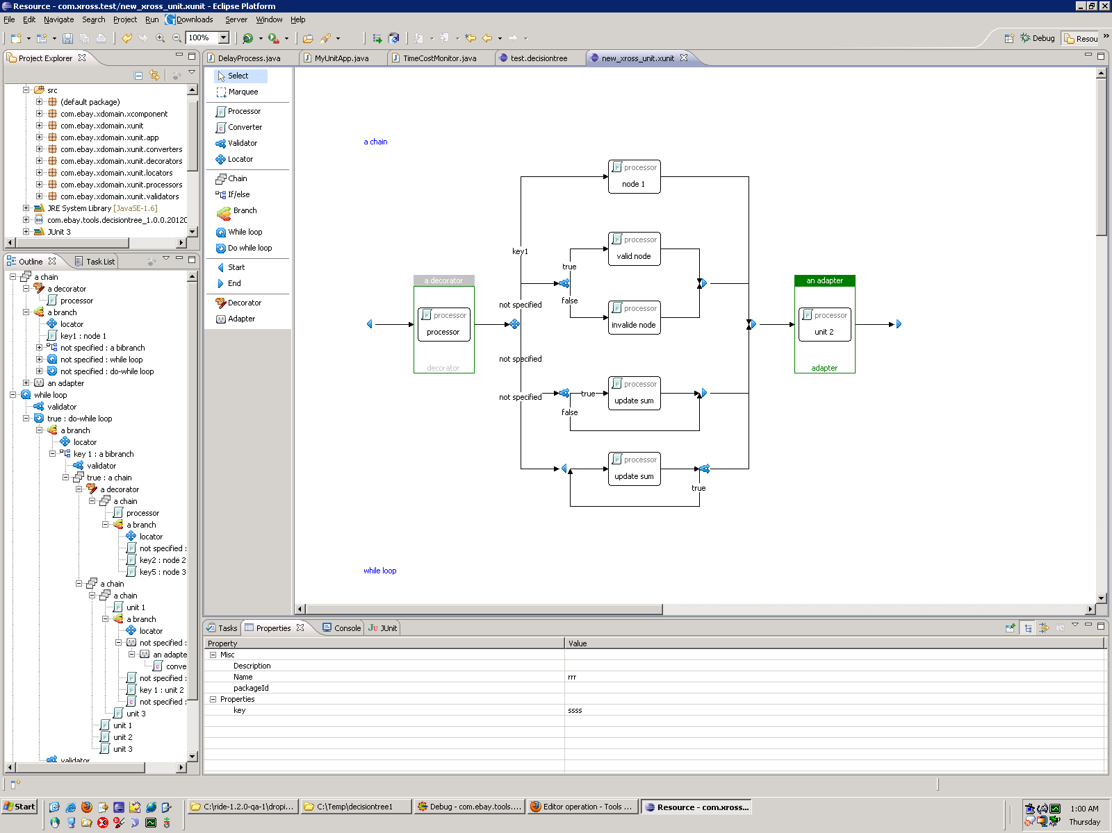
Xross Unit

Slide 30
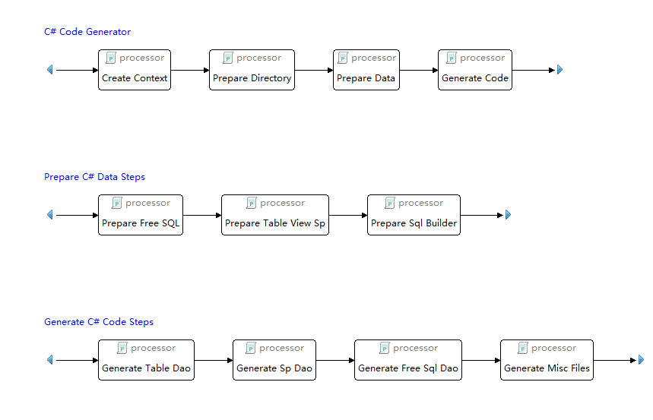

Xunit in Dal Code Gen

Slide 31
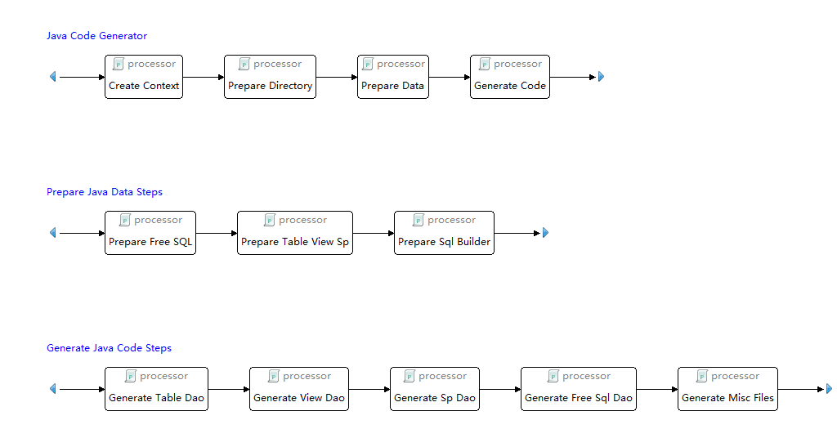

Slide 32
Decision tree
What is decision tree
  A common tool used in business intelligence domain
  To represent complex decision making path in a tree model
Decision Tree Editor enables developer
  Create decision tree
    Within eclipse in WYSIWYG way
  Specify Factors
    Variable that has several value
  Specify Decision
    Key that identifies particular decision result
  Generate unit test code to verify the tree model
    Cover all paths that a decision can be reached
Benefit
  Pure model, no code.
  Can be reused

Slide 33
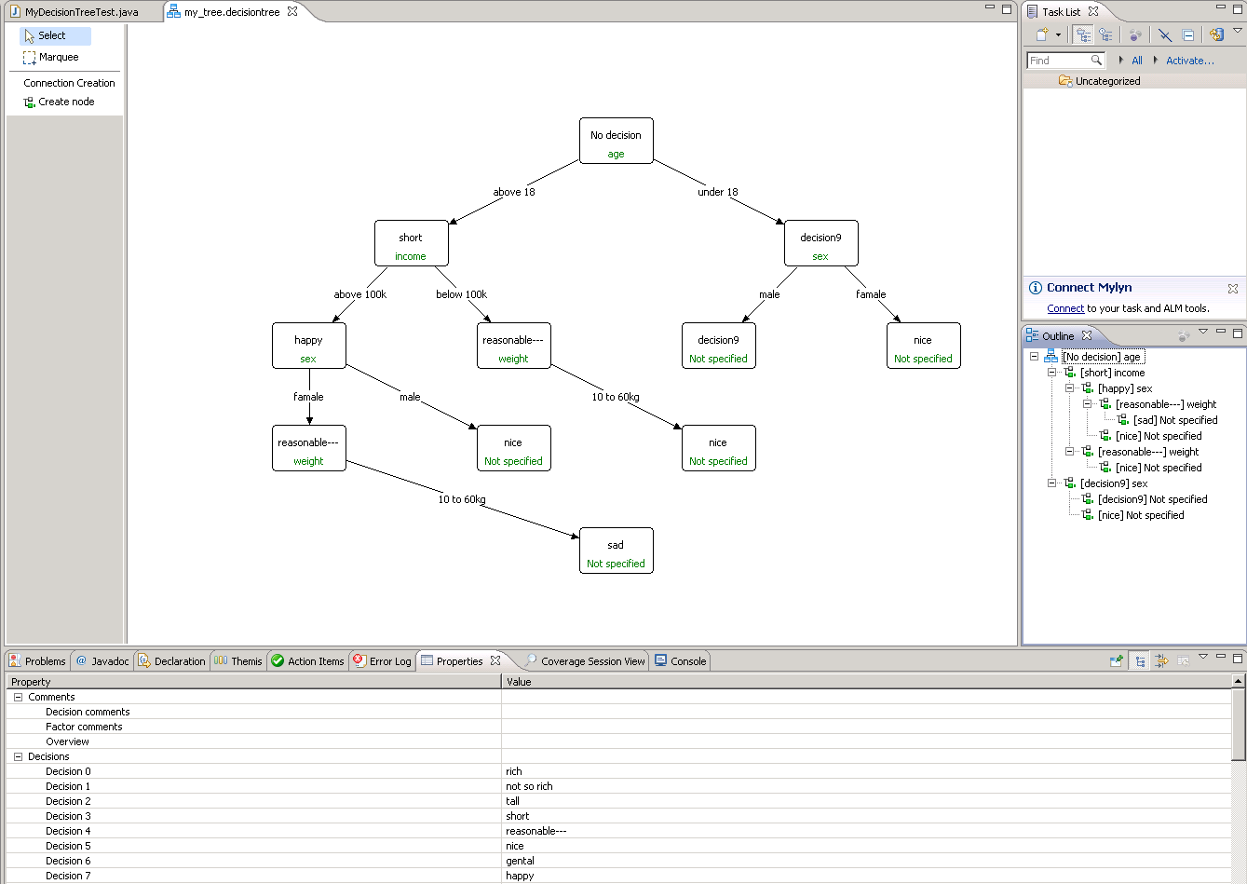
Decision tree

Slide 34
Xross State
Still under development
A state machine editor that allow developer create state machine to represent workflow
Like decision tree, it cares only the state machine model.
No couple with client code
The model file can be parsed by runtime to trigger state transition

Slide 35
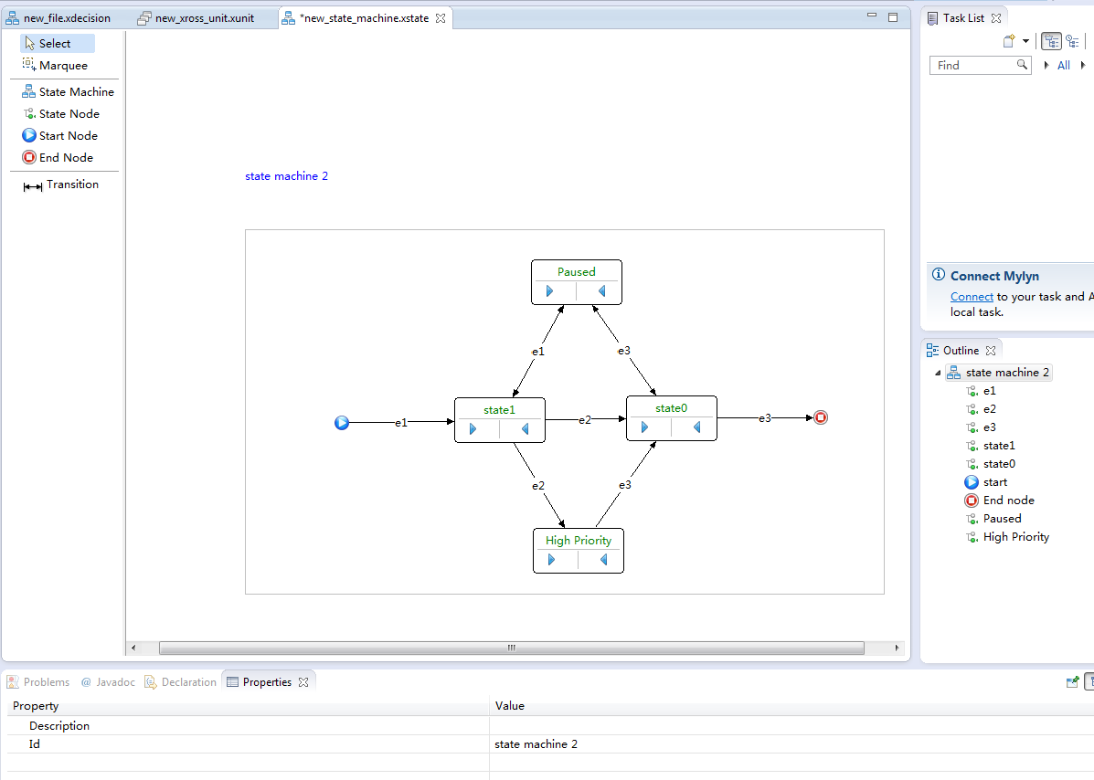
Xross State

Slide 36
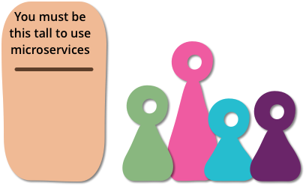
The Next
XEDA
  SEDA/Microservice implementation
  Service transition
  Managing/Monitoring

Slide 37
X serial resource
https://github.com/hejiehui?tab=repositories

Slide 38
Q&A
问题比答案更重要

